Slide 1

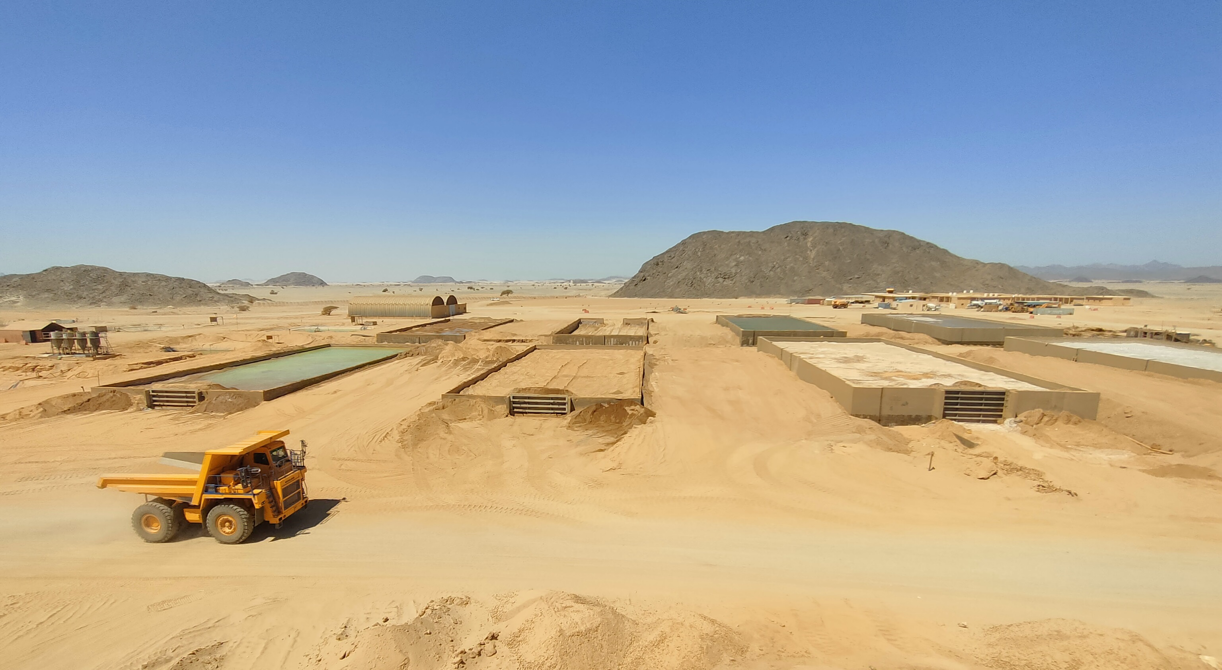
Wealth & Resources Mining S.A.E.

Slide 2
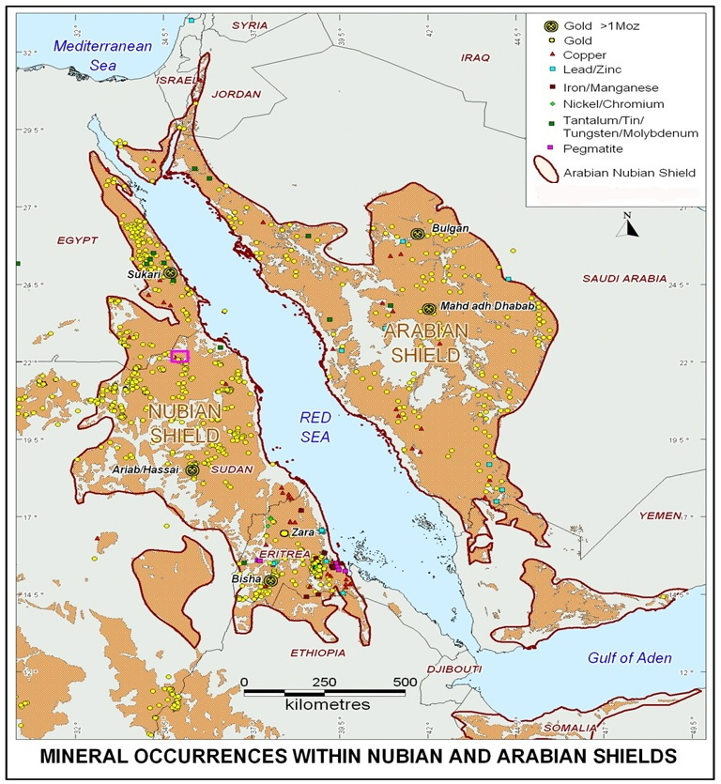
Wealth & Resources Mining S.A.E.
The Arabian-Nubian Shield
Often hailed as the ‘holy grail’ of mining, is poised to become Egypt’s cornerstone mineral asset, propelling economic growth and development.
This vast geological formation, spanning Egypt, Jordan, Ethiopia, Saudi Arabia, and Sudan, is a treasure trove of precious metals and minerals.
Doing Business in Egypt
Major signatory to multinational and bilateral trade agreements (8 trade)
c.10% of world trade passes through the Suez Canal.
Abundance of resources and committed to grow mining similar to O&G sector.
– O&G US$40 Bn (c.15% GDP and c.50% FDI - Incl. BP, ENI, Shell)
– c.0.5 M ounces of gold produced per annum (with significant upside potential)
Extensive Country-Wide Infrastructure
190,000 km country-wide paved road network, connecting 9 main ports and 11 airports
Extensive gov’t development programs in road, ports, hydro/wind/solar power, etc.
Right Geological Time & Place.

Slide 3
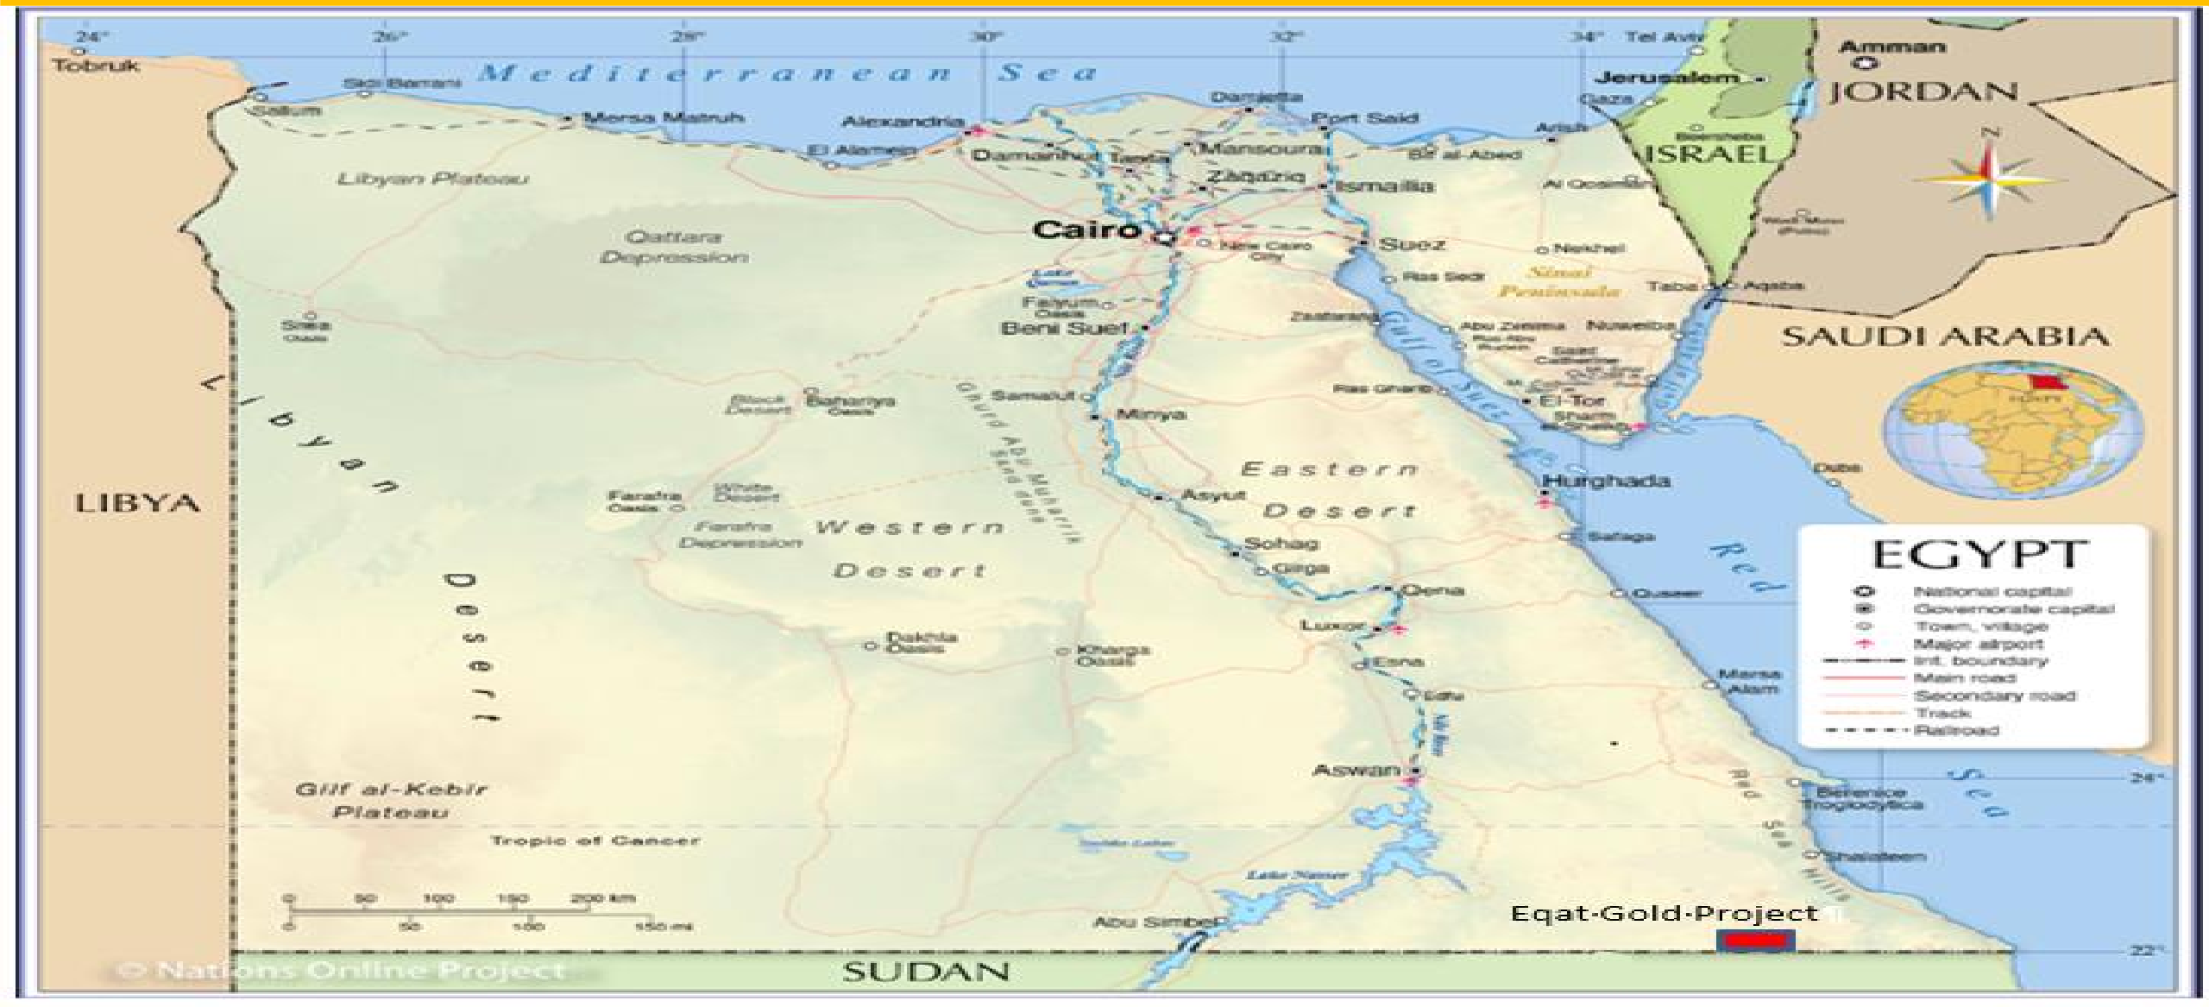
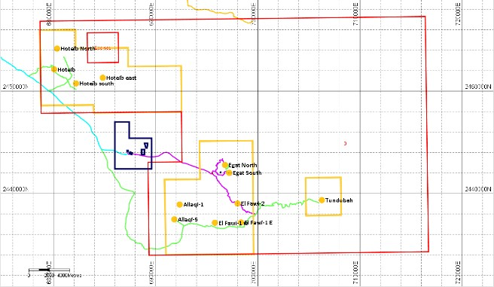
Wealth & Resources Mining S.A.E.

Slide 4
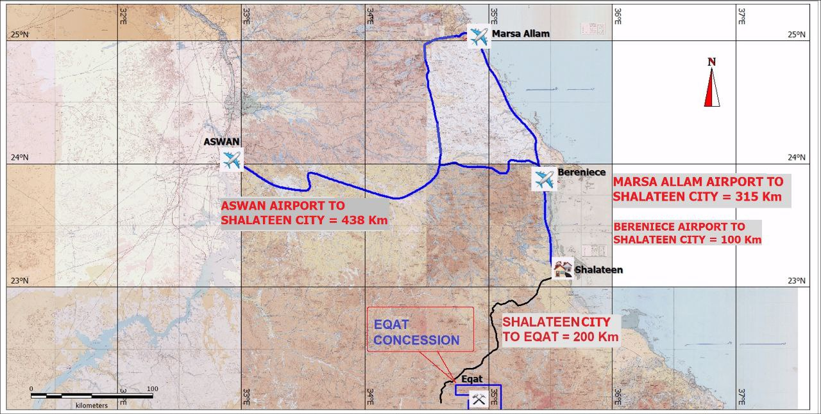
Wealth & Resources Mining S.A.E.
The Eqat Concession is in the south of The Egyptian Eastern Desert,
520 km from Marsa Alam Airport,
200 km Southwest from Shalateen City,
The Eqat Gold Mine Site can be easily reached along the Shalateen – Sohein asphalt road (180 km) and then 22 km along a formed gravel road to the project site.
Commercial air flights (EgyptAir,Air Cairo) operate from the Marsa Alam airport.

Slide 5
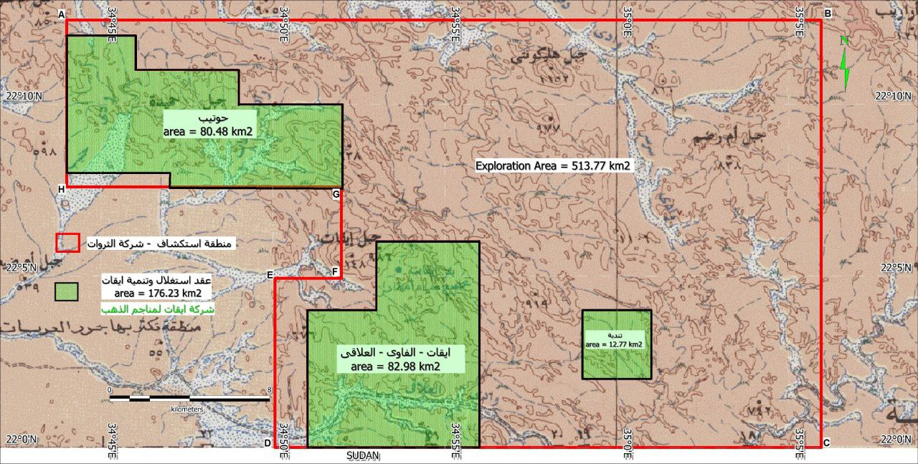
Wealth & Resources Mining S.A.E.
Eqat Concession total area: 690 km2.
Eqat Exploitation & Development Lease: 176.23 km2.
  Tondubah : 12.77 km2
  Eqat, Fawi, Allaqi : 82.98 km2
  Hotieb : 80.48 km2
Eqat exploration area: 513.77 km2.
Exploration done according to the Australian JORC Code.
2025 Resource 2.25 Moz:
  1.607 Moz Measured & Indicated.
  644 Thousand Inferred.
Mine Life : 11 years.
Capital invested by Wealth & Resources Mining to date:
approx. 45 million USD.

Slide 6
Wealth & Resources Mining S.A.E.
2018
Wealth and Resources Mining Company (WRM) started exploration for Gold in Eqat Concession (area : 690 km2).
2020
2021
WRM Operator - Eqat Gold Mine Company established (EMRA, SMRC & WRM).
Resource update 2.25 Moz, PFS Completed for CIL plant production, DFS started.
2025
Gold production continue, PFS started with NewPro – Australia.
2024
Gold bars export started to ASAHI Refinery in Canada, Resource update 2.04 Moz.
2023
Permits issuing (Environment, Industrial, …etc.) – Vat Leaching Production Facility establishment.
2022
Commercial Discovery with 1.1 Millon Oz of Gold, Mine license issued.

Slide 7
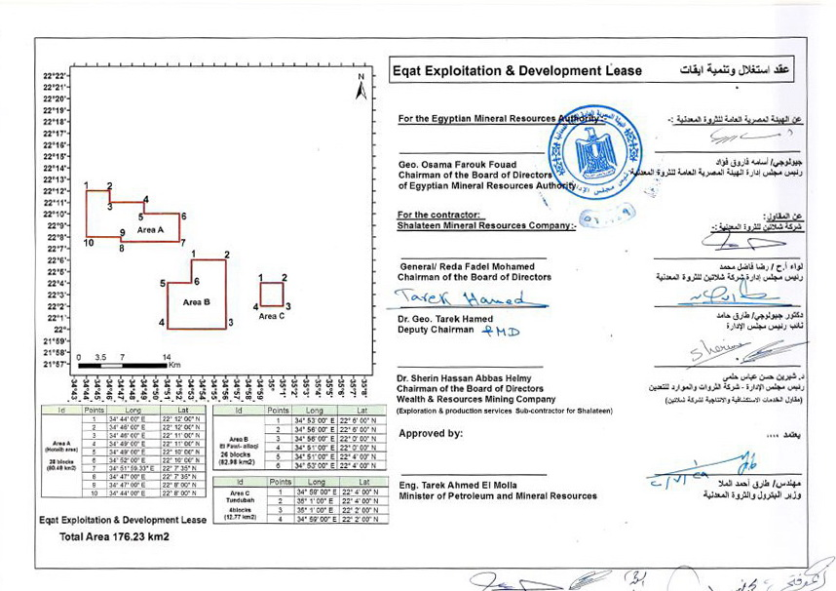
Wealth & Resources Mining S.A.E.
Eqat Gold Mine – Eqat Development Lease (Mine Leciense)
Notes:
Drilling at Eqat has been a logistical challenge due to the steep topography

Slide 8
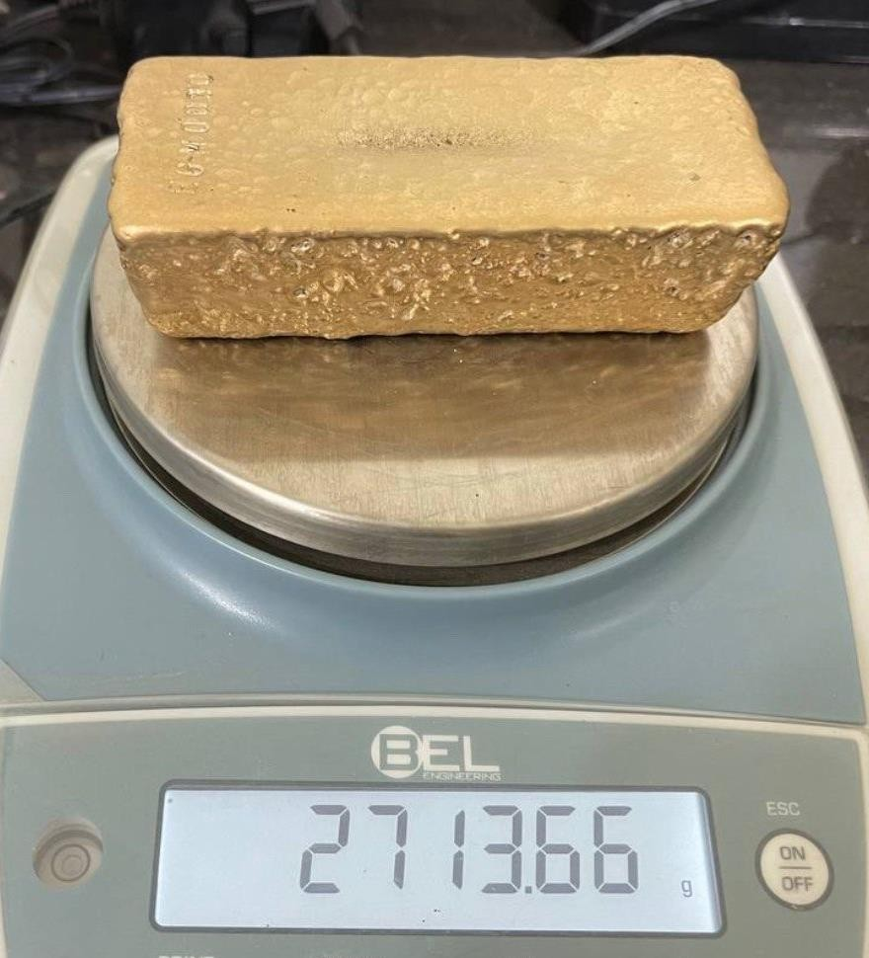
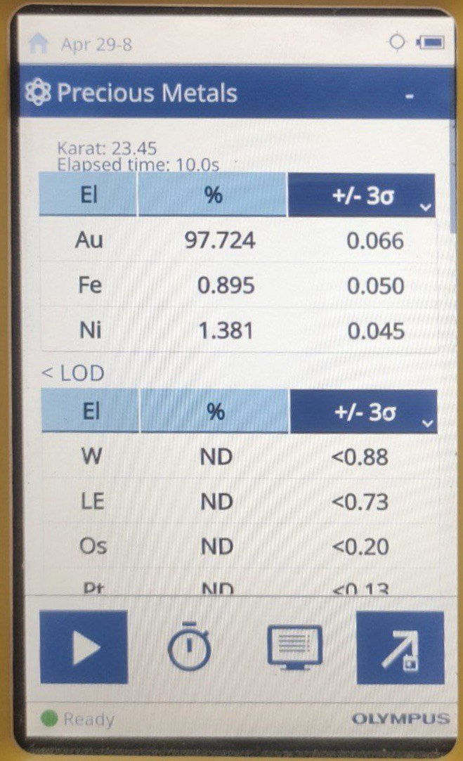
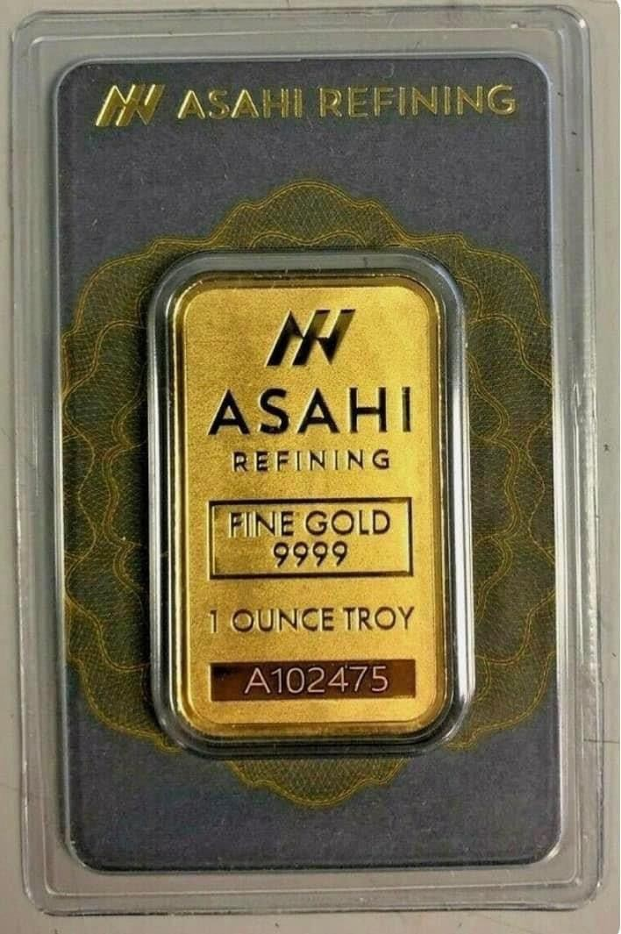
Wealth & Resources Mining S.A.E.
Notes:
Drilling at Eqat has been a logistical challenge due to the steep topography

Slide 9
Wealth & Resources Mining S.A.E.
Production Gold Sharing
 | Unit | Quantity | % | Entity / Company
Produced Gold | kg | 100
Royalty | kg | 5 | 5% | Ministry of Finance
Remaining (C.R. & Profit) | kg | 95
Cost Recovery Gold | kg | 61.75 | 65% | Wealth & Resources Mining Co. (WRM)
Remaining (Profit Gold) | kg | 33.25
Profit Gold WRM | kg | 16.63 | 50% | WRM
Total WRM Gold | kg | 78.375
Profit Gold EMRA | kg | 10.30 | 31% | Egyptian Mineral Resources Authority - EMRA
Profit Gold SMRC | kg | 6.31 | 19% | Shalateen Mineral Resources Company - SMRC

Slide 10
Wealth & Resources Mining S.A.E.
Notes:
Drilling at Eqat has been a logistical challenge due to the steep topography

Slide 11
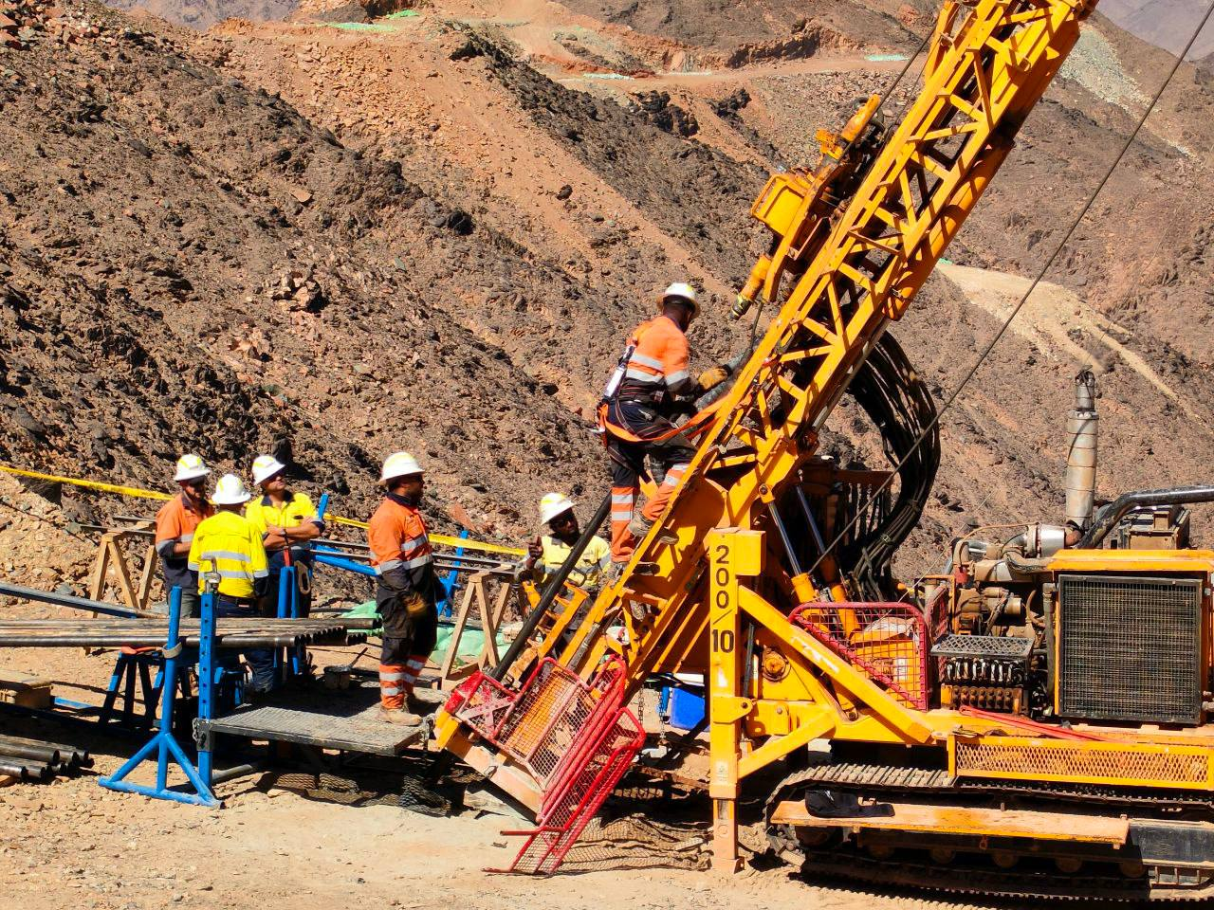
Wealth & Resources Mining S.A.E.
Eqat Gold Project – Summary of Exploration Work Completed to Jan 2026
Item | Total to Date
Acquisition & Interpretation of satellite imagery | 800 km2
Geological mapping & Interpretation | 695 km2
Structural study | Eqat & El Fawi
Geochemical sample (surface) | > 11,000 Samples
Drilling (RC & Diamond) | 828 holes, 99,559 m
Drilling samples (RC / Diamond) | 44,903
Metallurgical & Geotech. sample | 1,886
Total samples Assyed to date | 57,789
Access roads constructed | > 120 km
Gold Occurrences Located | 56 Occurrences
Drainage sampling
Notes:
Early work included interpretation of remote sensing data followed by regional drainage sampling and geological mapping. This was followed by rock-chip sampling and drilling.

Slide 12
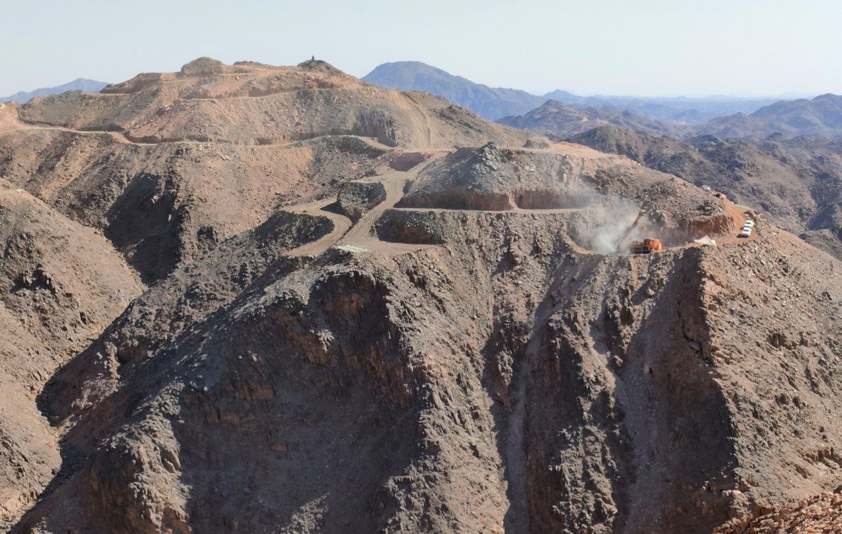
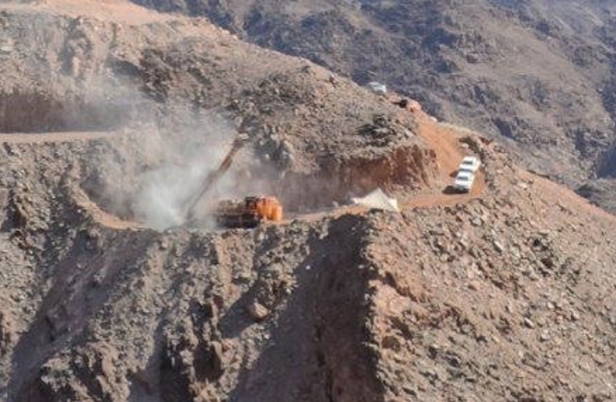
Wealth & Resources Mining S.A.E.
Eqat Gold Project – Drilling on the edge
Notes:
Drilling at Eqat has been a logistical challenge due to the steep topography

Slide 13
Wealth & Resources Mining S.A.E.
Eqat Gold Project – Mineral Resources : 2025
The combined Mineral Resources of the Eqat and El Fawi-2 deposits contain:
At 0.25 g/t Au lower cut-off :
  The total tonnes is 44.5 Mt at a grade of 1.57 g/t Au (cut grade 1.35 g/t) containing 2.251 Moz of gold (cut 1.948 Moz).
At 0.1 g/t Au lower cut-off :
  The total tonnes is 64.1 Mt at a grade of 1.41 g/t (uncut) containing 2.904 Moz (uncut).

Slide 14
Wealth & Resources Mining S.A.E.
Eqat Gold Project – Mineral Resources : 2025 (2.251 Moz, at lower cut off 0.25 g/t)

Slide 15
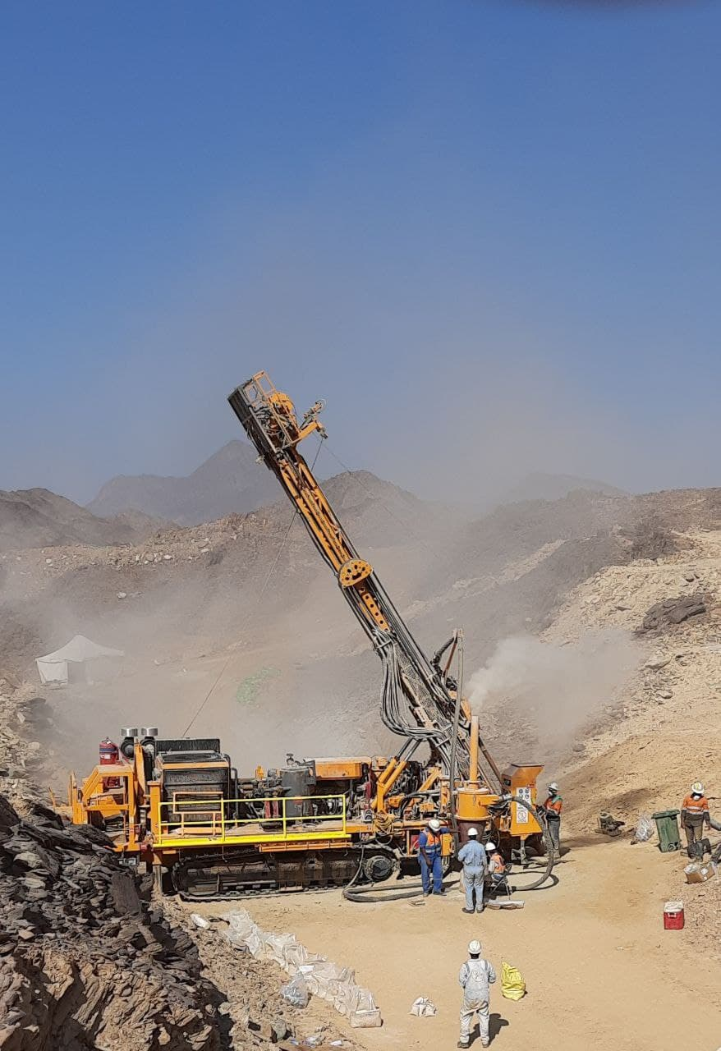
Wealth & Resources Mining S.A.E.
Eqat Gold Project – Mineral Resources : 2025 (2.9 Moz at lower cut off 0.1 g/t)
Eqat + El Fawi-2 | Mineral Resources (Mt) | Grade g/t Au | Containe 1,000 Oz
Measured | 12.90 | 1.24 | 515.99
Indicated | 33.6 | 1.07 | 1,158.42
Inferred | 17.6 | 1.32 | 746.63
Total | 64.1 | 1.41 | 2,904.38

Slide 16
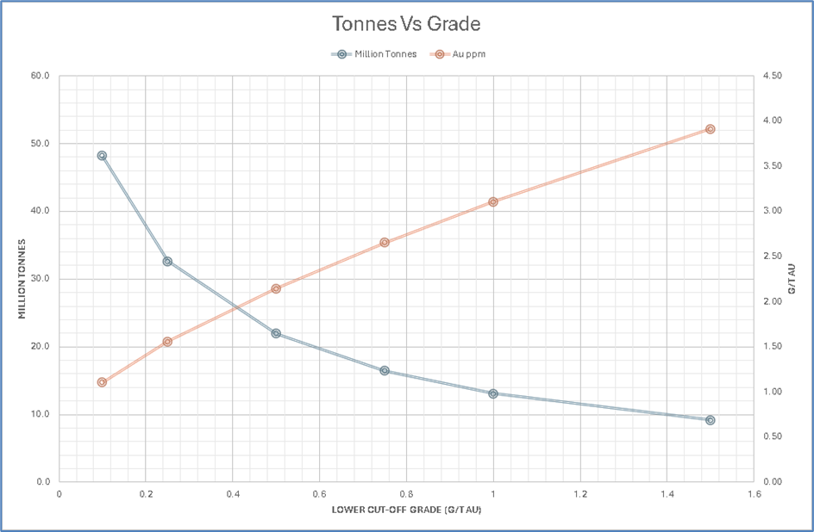
Wealth & Resources Mining S.A.E.
Eqat Gold Project – Mineral Resources : 2025 (2.251 Moz)

Slide 17
Wealth & Resources Mining S.A.E.
Eqat Gold Project – Exploration Target : 2025
In addition to the Mineral Resources an Exploration Target of approximately 1.8 to 8.8 million tonnes at 1.2 to 1.5 g/t Au was estimated below the Egat Mineral Resource.
And a further Exploration Target of approximately 0.6 to 3.3 million tonnes at 1.2 to 1.5 g/t Au was estimated below the El Fawi-2 Mineral Resource down to 400m RL.
It must be noted that the potential quantity and grade of an Exploration Target estimate is conceptual in nature as there has been insufficient exploration to estimate a Mineral Resource and it is uncertain if further exploration will result in the estimation of a Mineral Resource for this target.
JORC Clause 17
An Exploration Target is a statement or estimate of the exploration potential of a mineral deposit in a defined geological setting where the statement or estimate, quoted as a range of tonnes and a range of grade (or quality), relates to mineralisation for which there has been insufficient exploration to estimate a Mineral Resource.

Slide 18
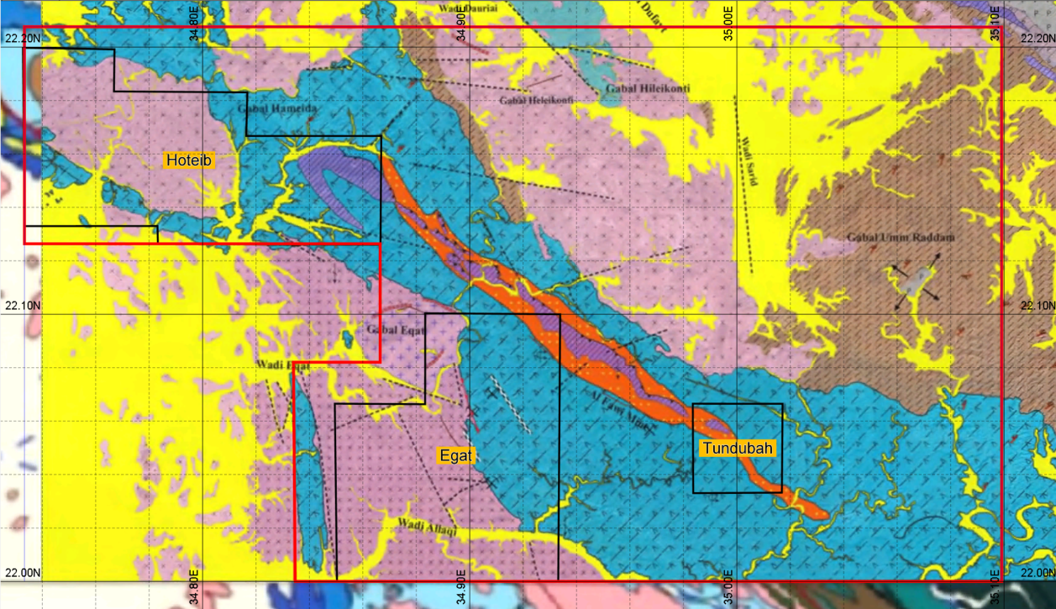
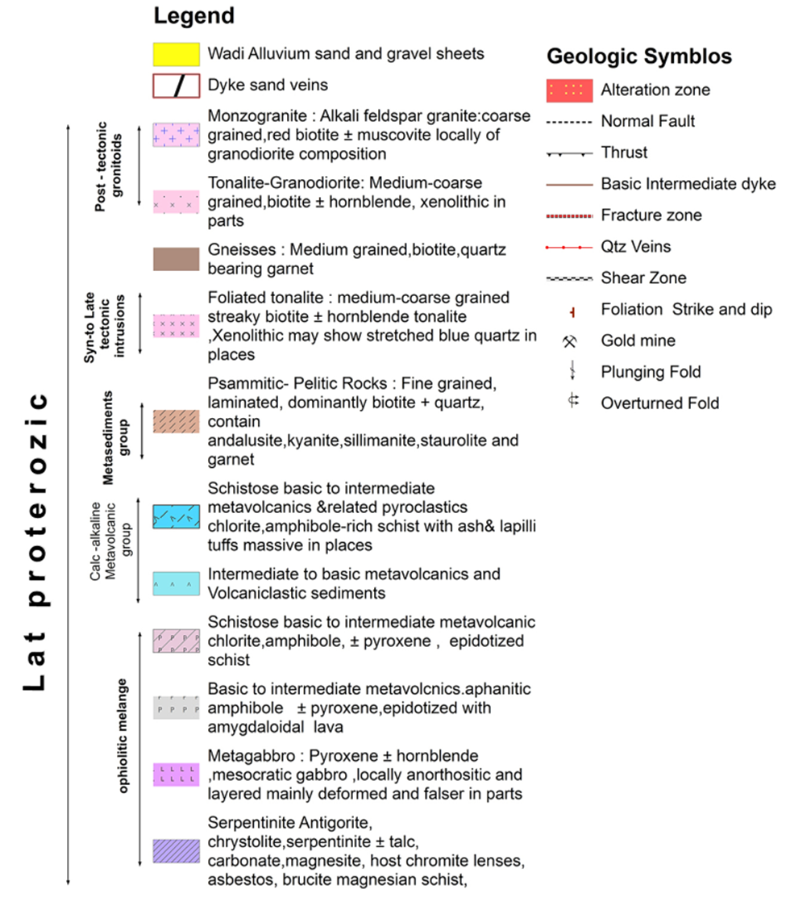
Wealth & Resources Mining S.A.E.
Eqat Gold Project – Geology

Slide 19
Wealth & Resources Mining S.A.E.
Eqat Gold Project – Eqat North
Hole-ID | From (m) | To (m) | Interval (m) | Au-g/t (uncut)
ERC350 | 45 | 69 | 24 | 2.52
including | 45 | 61 | 16 | 3.23
ERC359 | 55 | 71 | 16 | 3.33
ERC375 | 114 | 134 | 20 | 3.07
ERC375 | 115 | 132 | 17 | 3.58
ERC377 | 54 | 84 | 30 | 7.04
including | 54 | 68 | 14 | 6.71
including | 70 | 79 | 9 | 12.31

Slide 20
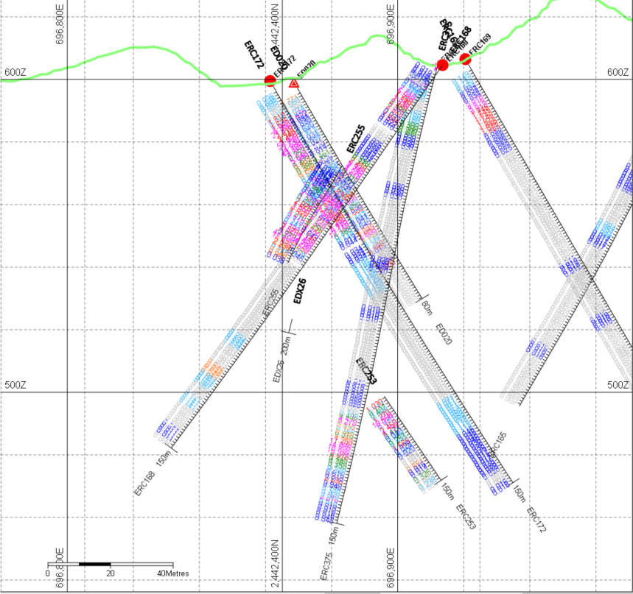
Wealth & Resources Mining S.A.E.
Eqat Gold Project – ERC375

Slide 21
Wealth & Resources Mining S.A.E.
Eqat Gold Project – El-Fawi 2
Hole-id | From (m) | To (m) | Interval (m) | Au-g/t (uncut)
FRC134 | 72 | 100 | 28 | 3.82
including | 80 | 93 | 13 | 7.46
FRC138 | 1 | 36 | 35 | 3.82
including | 1 | 26 | 25 | 5.14
FRC141 | 112 | 171 | 59 | 2.77
including | 126 | 137 | 11 | 8.25
FRC142 | 121 | 195 | 74 | 2.02
ERC142 | 177 | 195 | 18 | 4.23
FRC143 | 109 | 174 | 65 | 4.83
including | 130 | 173 | 43 | 5.87
including | 191 | 197 | 6 | 3.42

Slide 22
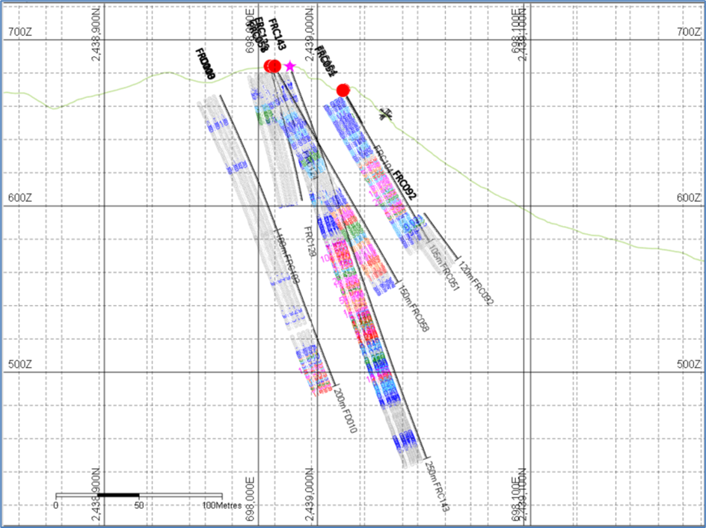
Wealth & Resources Mining S.A.E.
Eqat Gold Project – FRC143

Slide 23
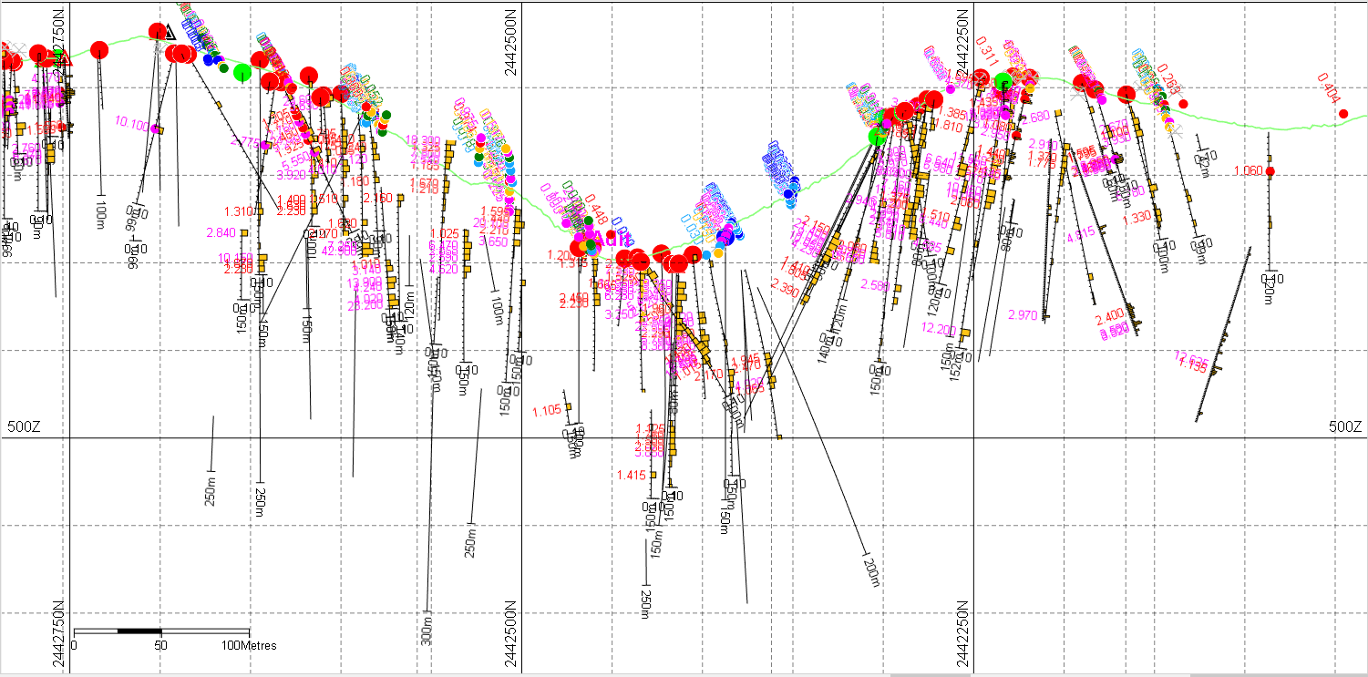
Wealth & Resources Mining S.A.E.
Eqat Gold Project – Longitudinal section – Egat North & South
230 m below top of ridge

Slide 24
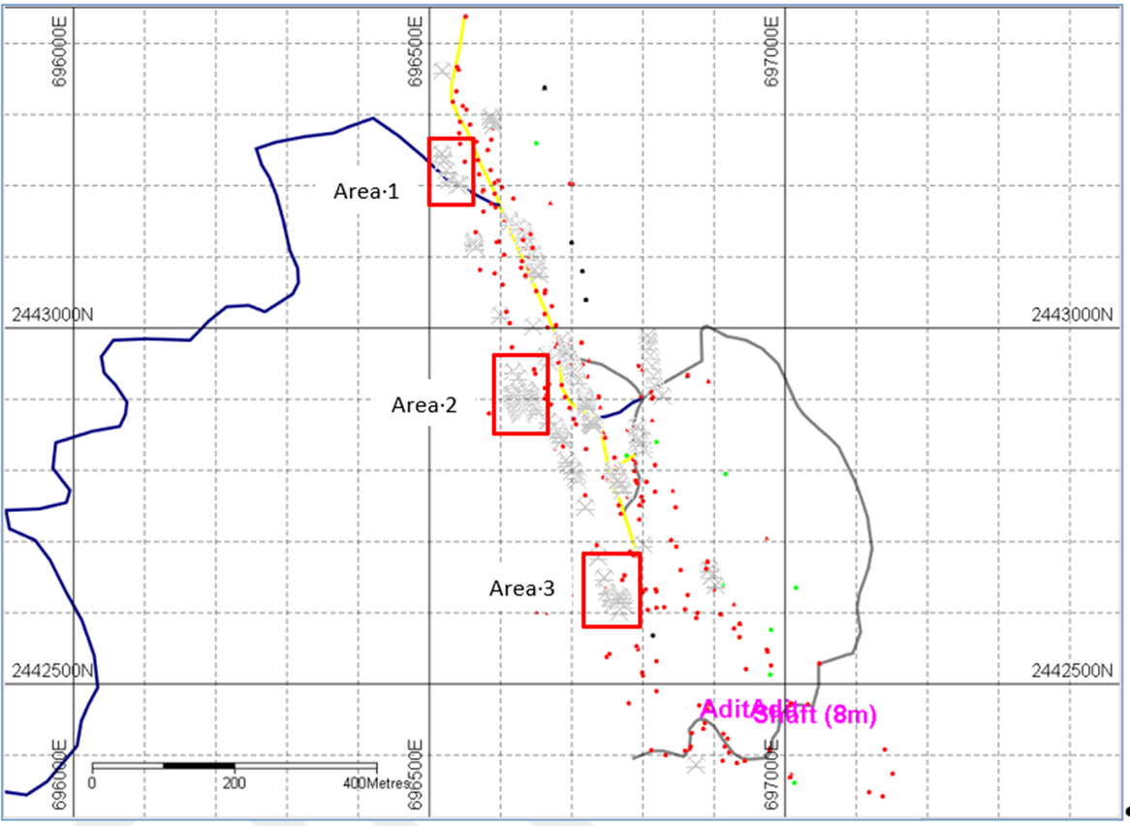
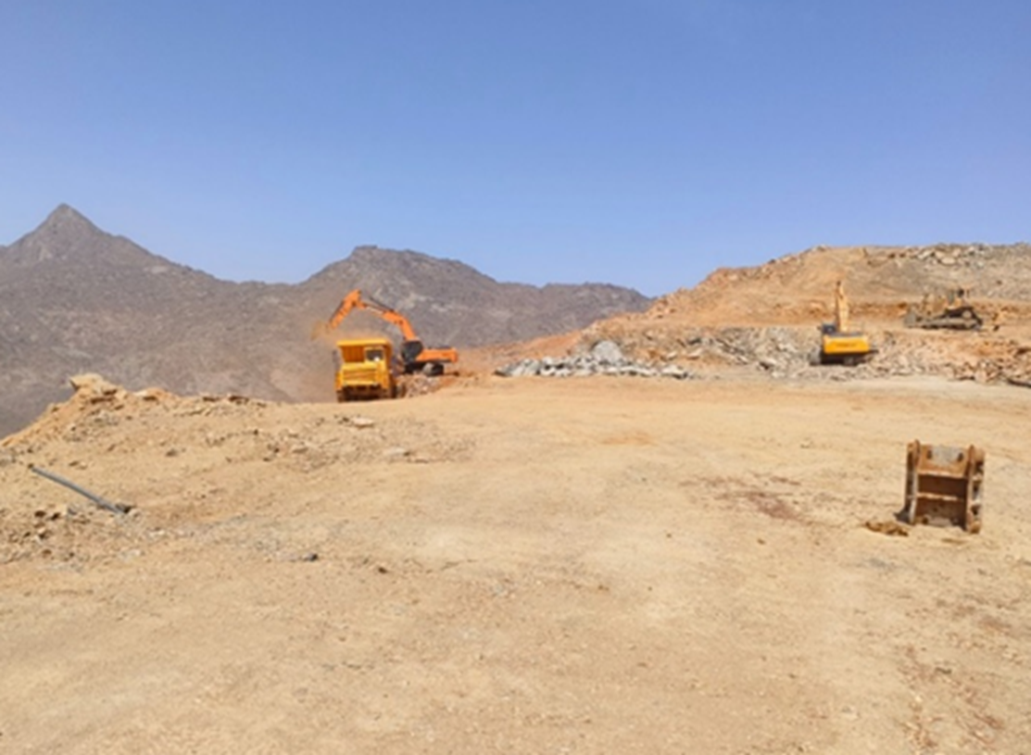
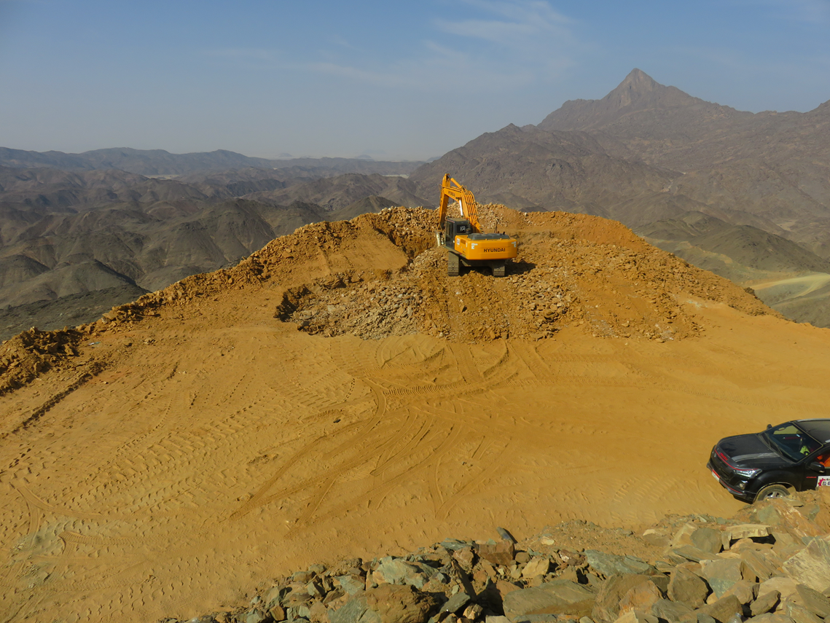
Wealth & Resources Mining S.A.E.
Eqat Gold Project – Mining Operations – Four active areas to blend ore grade
Area 4
Notes:
Mining from 4 active sites with the aim of obtaining a constant vat feed grade of 2-2.5. High-grade ore will be blended with the 1 g/t ore.
Another four potential mining areas are being examined at North Egat, two at south Egat and two at El Fawi-2.

Slide 25
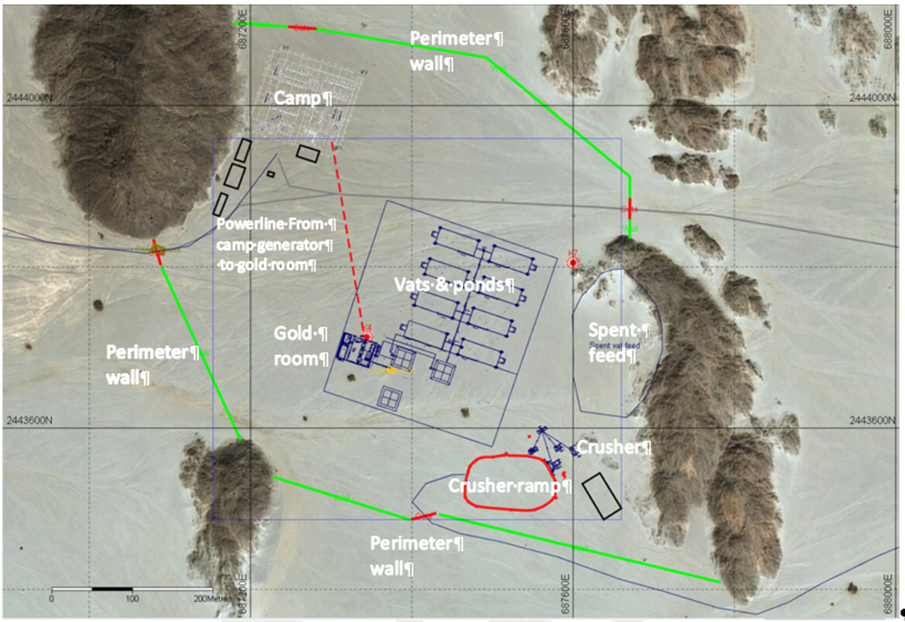
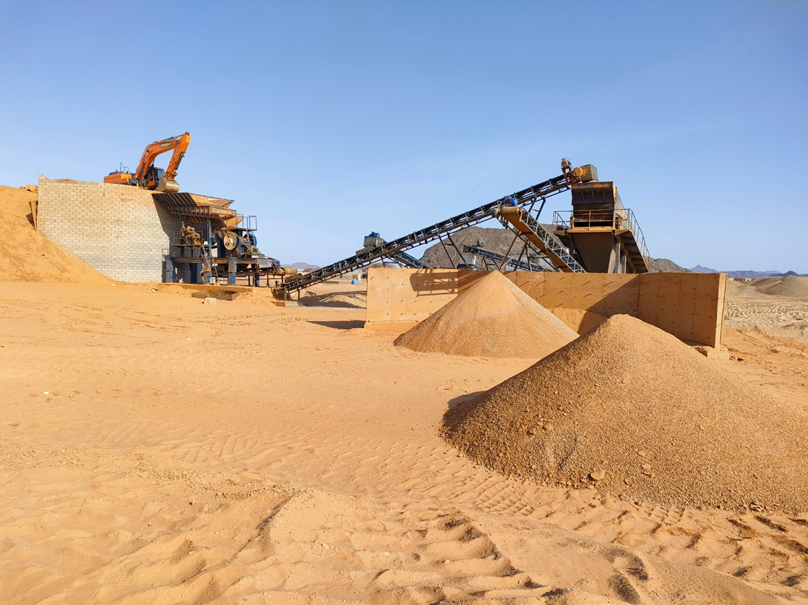
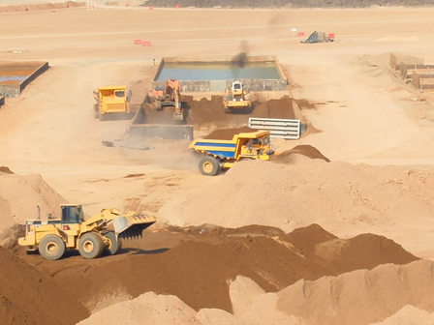
Wealth & Resources Mining S.A.E.
Eqat Gold Project – Mining Infrastructure
Area 4
Notes:
Mining from 4 active sites with the aim of obtaining a constant vat feed grade of 2-2.5. High-grade ore will be blended with the 1 g/t ore.
Another four potential mining areas are being examined at North Egat, two at south Egat and two at El Fawi-2.

Slide 26





Wealth & Resources Mining S.A.E.
Prefeasibility Study (PFS)
Currently WRM is done with the PFS report for processing a minimum of 3 million tons of Ore per year to produce Approx. 150 thousands Oz per year using Hybrid CIL Technology.
The PFS is done through NewPro Consulting & Engineering Services Pty Ltd – Australia.
In cooperation with:
Fortin Pipelines – Australia.
AMC Consultants – Australia.
ALS Labs – Australia.
Aggreko – UK.

Slide 27
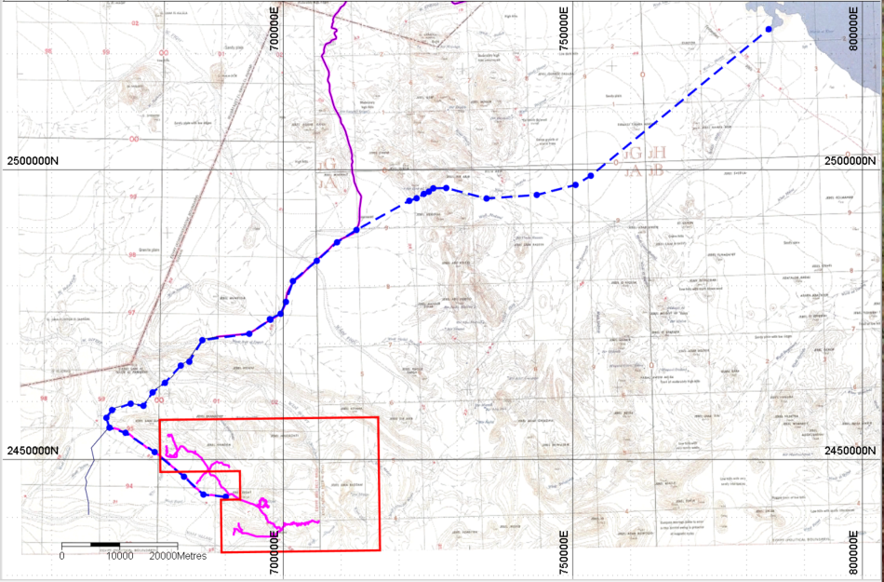
Wealth & Resources Mining S.A.E.
Eqat Gold Project – Pipeline
Notes:
Drilling at Eqat has been a logistical challenge due to the steep topography

Slide 28
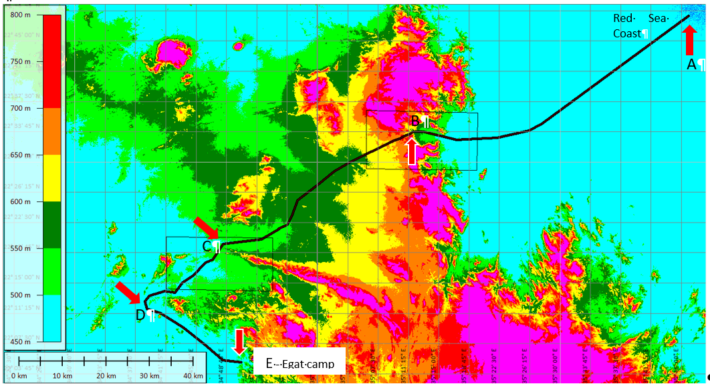
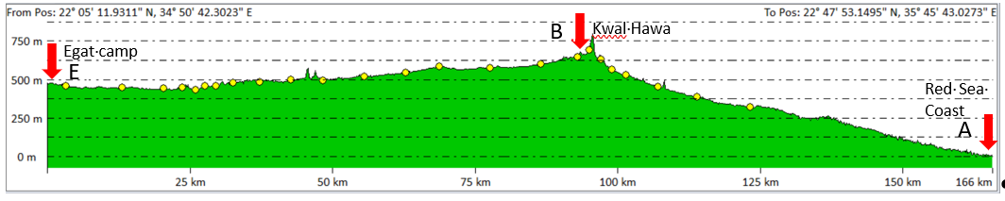
Wealth & Resources Mining S.A.E.
Eqat Gold Project – Pipeline

Slide 29
Wealth & Resources Mining S.A.E.
Eqat Gold Project –Technical team leaders
Dr John Chisholm - Geologist
BSc (Hons) PhD FAusIMM
General Manager & Exploration Manager
Dr Chisholm has over 50 years’ experience in mineral exploration for multiple commodities throughout five continents.
John Dunlop - Mining Engineer
BE, MEngSc, PCertArb, FAusIMM (CP), FIMMM. MCIMMM, MSME, MMICA.
Senior Mining consultant
Mr Dunlop has over 50 years’ experience in all aspects of mining with technical, legal and commercial assignments throughout Australia and overseas. He is a qualified arbitrator; court “expert” and mineral asset valuer.
Philip. Jones – Geologist
BAppSc (App. Geol), MAIG, MAusIMM
Independent Consultant
Mineral Resource Estimation
FAusIMM : Fellow at Australasian Institute of Mining & Metallurgy
Mohamed Hadidy – Metallurgist
Processing Manager
BSc (special chemistry)
Mr Hadidy has over 16 years’ experience mineral processing and operations management in Africa mainly in regard to CIP recovery of gold.
Mark Moddejongen - Mining. Engineer
BE (Mining) FAusIMM (CP) RPEQ(Mining) CP QP
Contract mining engineer
Mr Moddejongen is a specialist in pit optimisation, mine design and scheduling. He has over 17 years’ experience in mining operations in 26 different countries.
Bernard Etschmann – Metallurgist
General Manager Processing & Engineering, MAusIMM
BSc Science in Extractive Metallurgy, WA School of Mines.
Mr. Bernard Etschmann has over 30 years’ experience in technical roles in gold associated with grinding and flotation and downstream treatment processes including CIL, CIP, cyanide detoxification, neutralization, and CCD washing.
Notes:
Environmental and Industrial permits approved

Slide 30
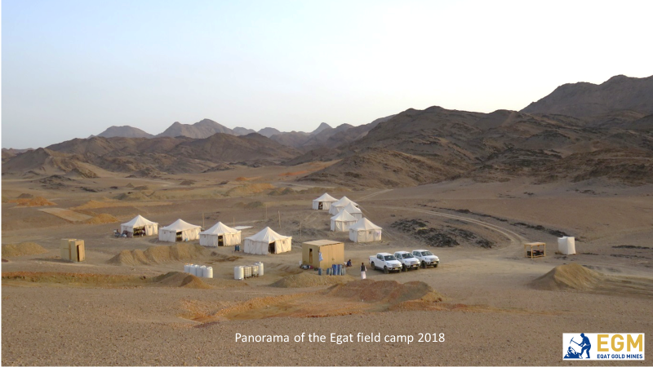
Wealth & Resources Mining S.A.E.
Eqat Gold Mine Project Start – 2018 (The Exploration Camp)
Notes:
Drilling at Eqat has been a logistical challenge due to the steep topography

Slide 31
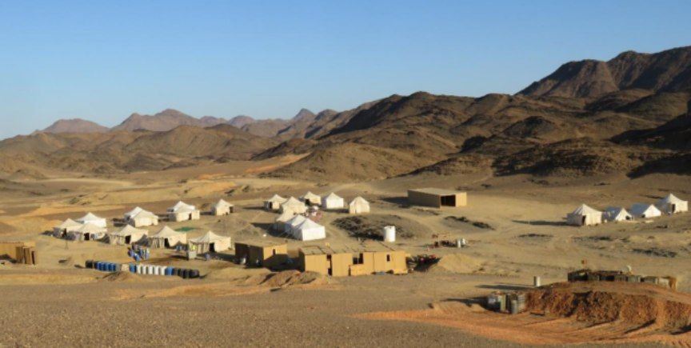
Wealth & Resources Mining S.A.E.
Eqat Gold Mine 2020
Notes:
Drilling at Eqat has been a logistical challenge due to the steep topography

Slide 32
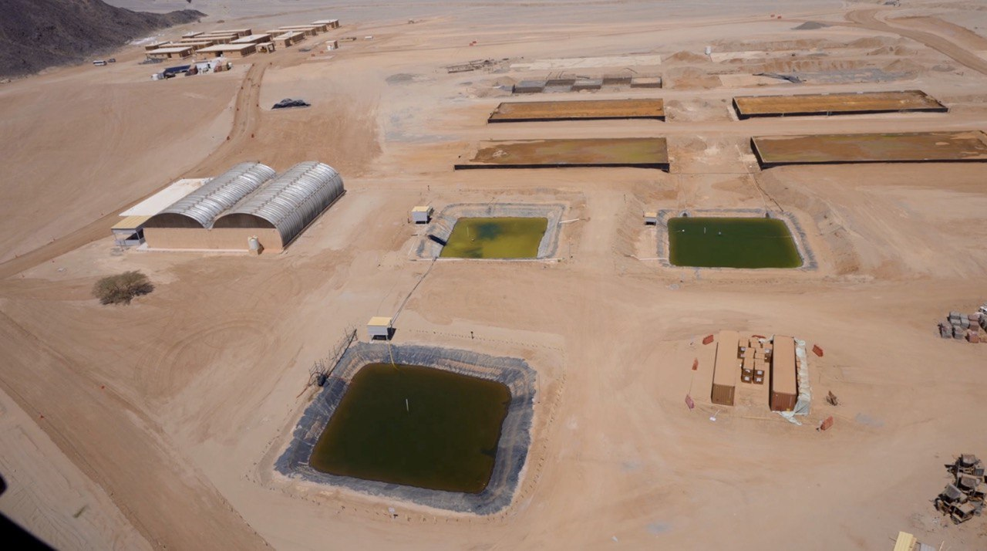
Wealth & Resources Mining S.A.E.
Eqat Gold Mine (Camp and Early Production Vat Leach System – 4 Vats, 3 Ponds) 2023
Notes:
Drilling at Eqat has been a logistical challenge due to the steep topography

Slide 33
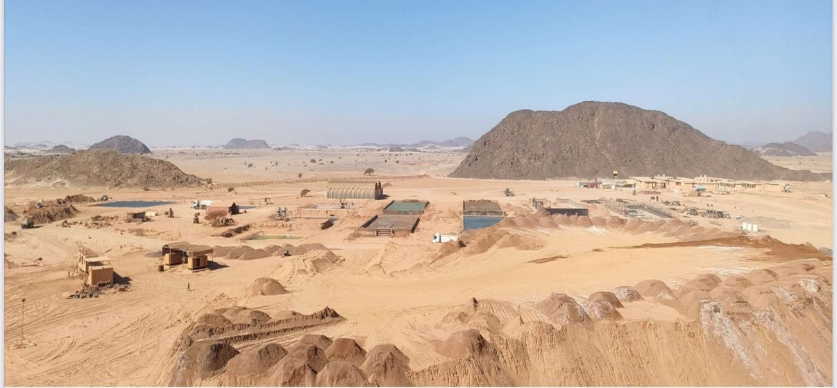
Wealth & Resources Mining S.A.E.
Eqat Gold Mine (Vat Leach System – 6 Vats, 5 ponds, 2 Carbon Cylinders) 2024
Notes:
Drilling at Eqat has been a logistical challenge due to the steep topography

Slide 34
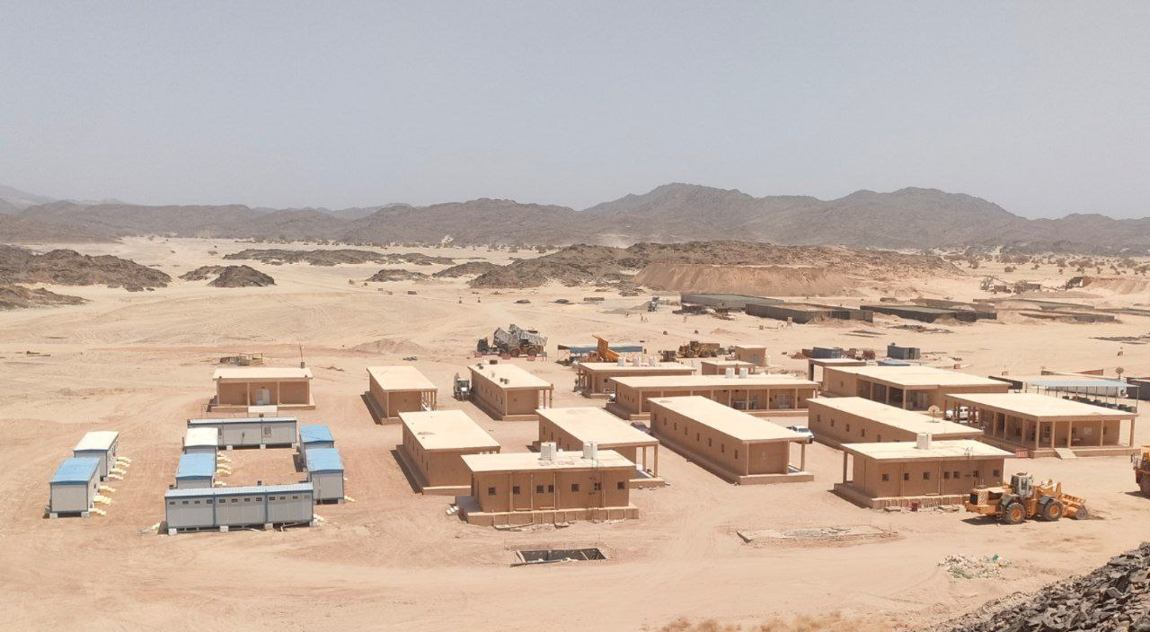
Wealth & Resources Mining S.A.E.
Eqat Gold Mine (Camp and Vat Leach System – 8 Vats , 5 ponds, 4 Carbon Cylind.) 2025
Notes:
Drilling at Eqat has been a logistical challenge due to the steep topography

Slide 35
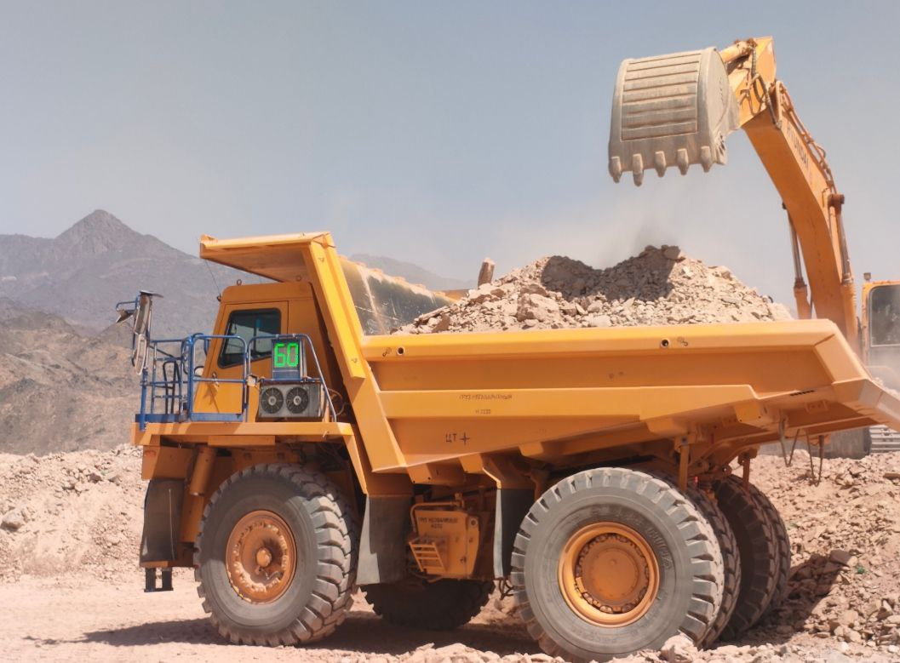
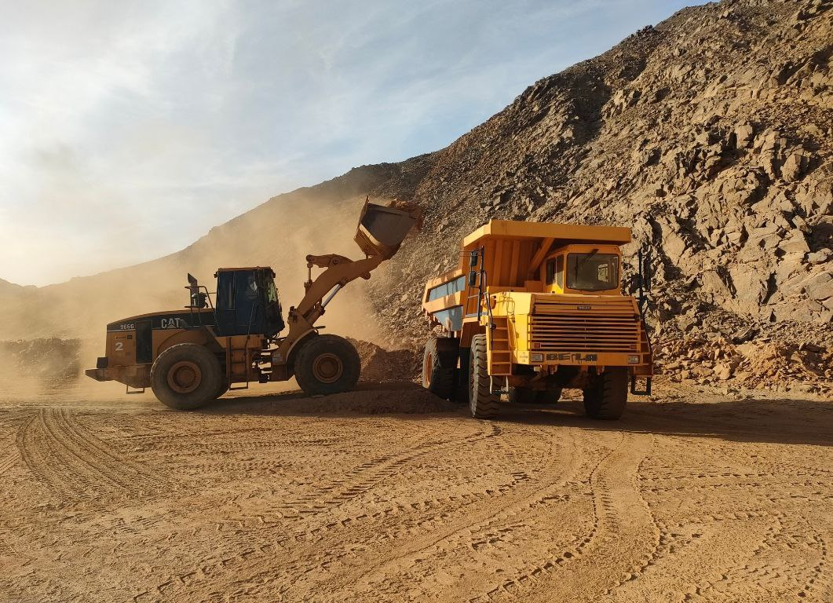
Wealth & Resources Mining S.A.E.
Eqat Gold Mine (Load & Haul)
Notes:
Drilling at Eqat has been a logistical challenge due to the steep topography

Slide 36
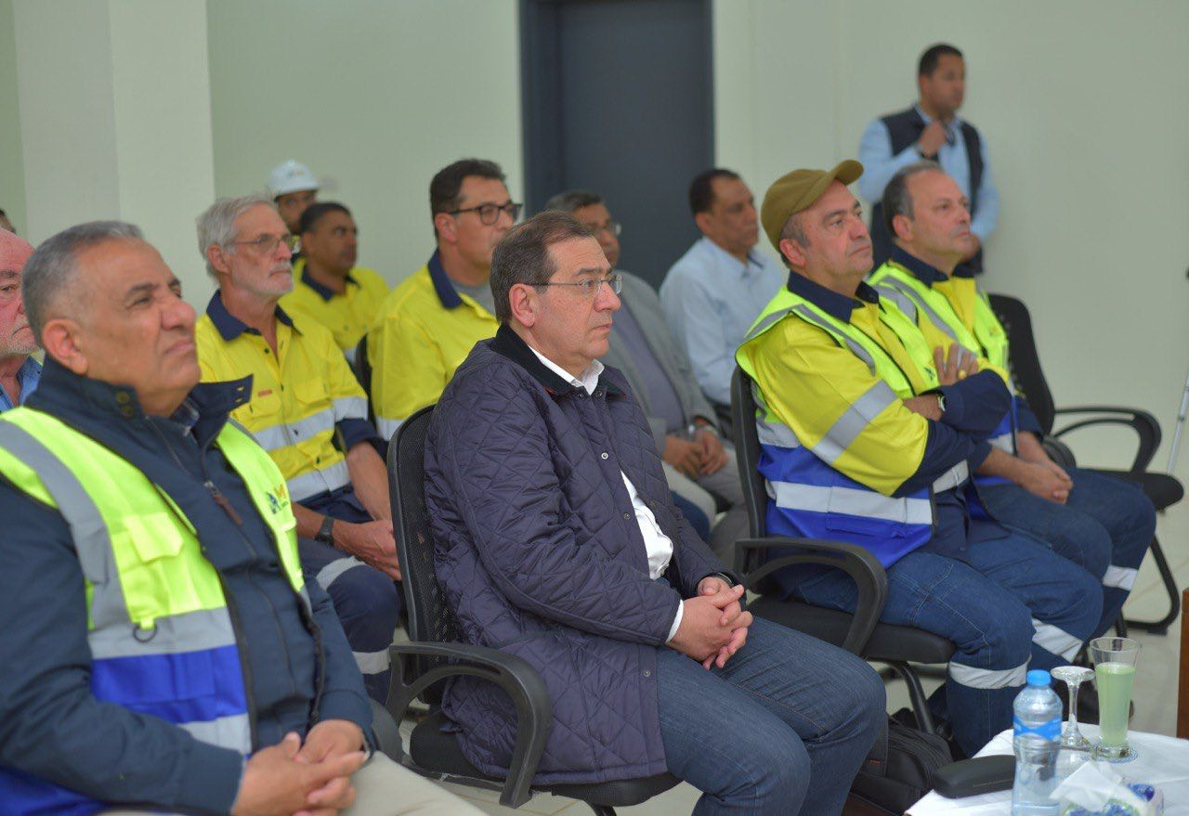
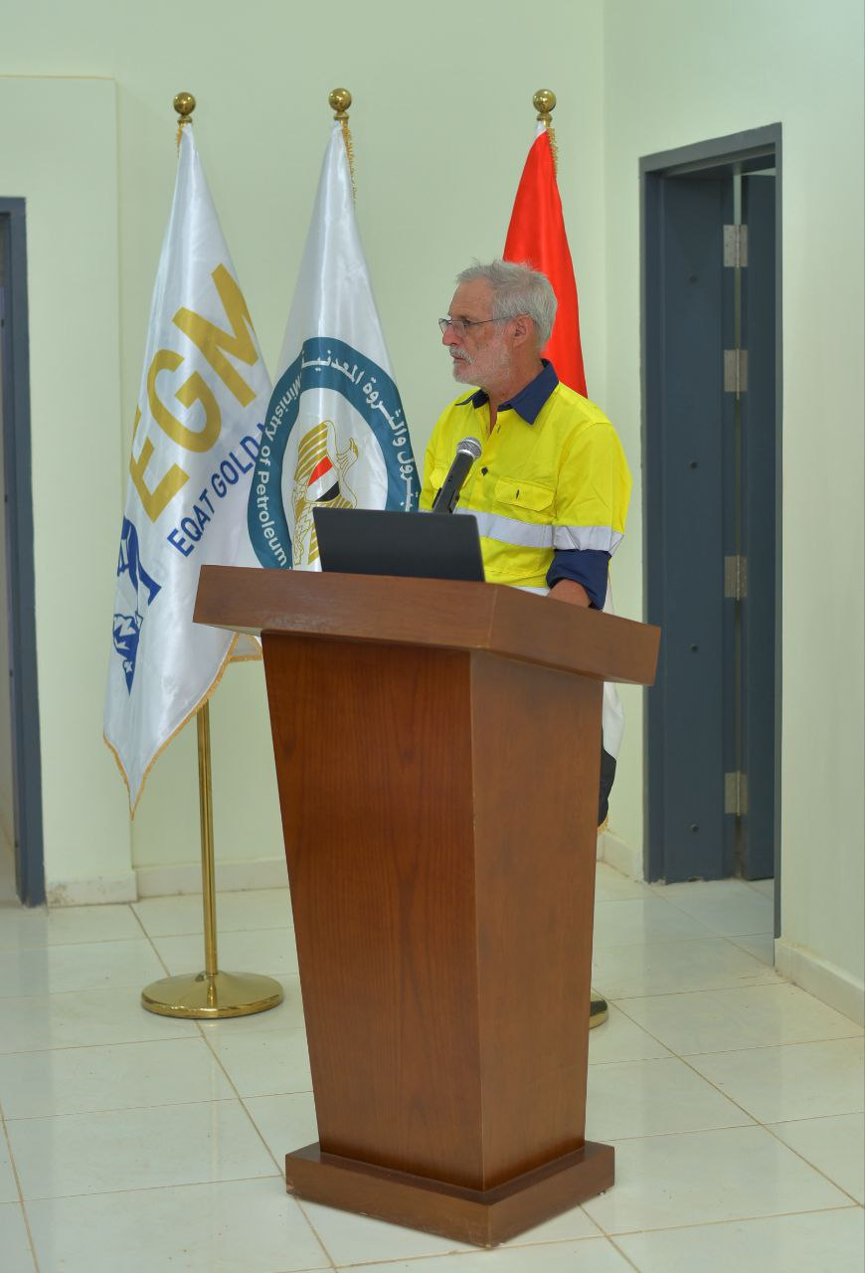
Wealth & Resources Mining S.A.E.
Minister of Petroleum & Mineral Resources visit to Eqat Mine Site (March 2023)
Notes:
Drilling at Eqat has been a logistical challenge due to the steep topography

Slide 37
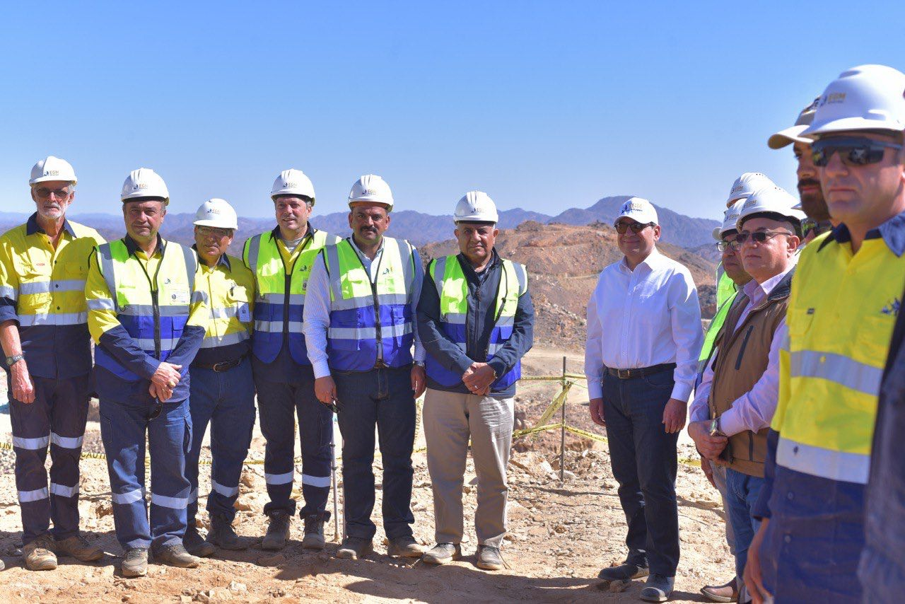
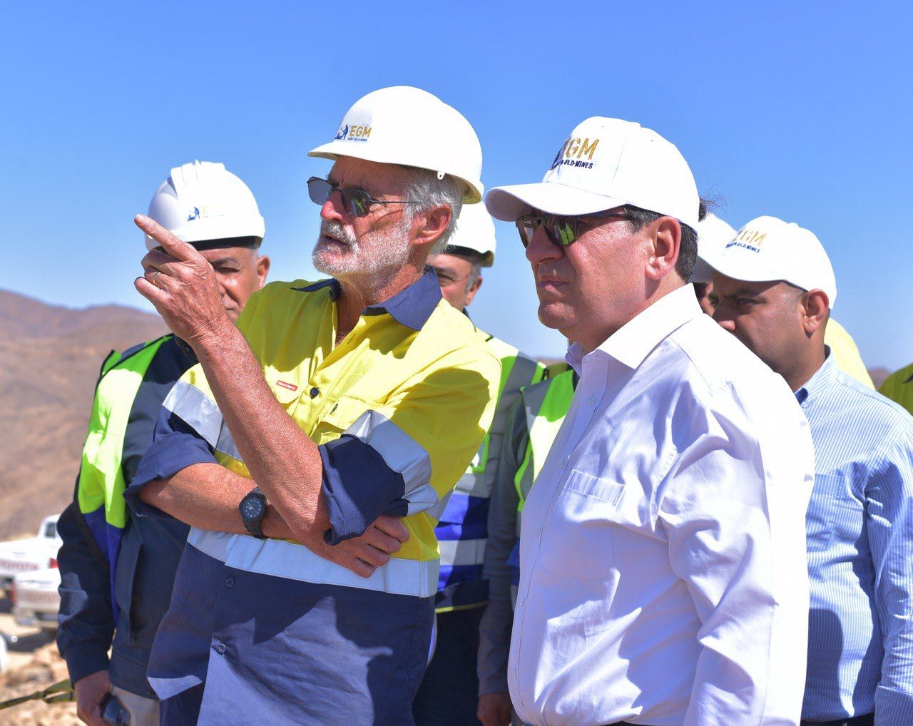
Wealth & Resources Mining S.A.E.
Minister of Petroleum & Mineral Resources visit to Eqat Mine Site (March 2023)
Notes:
Drilling at Eqat has been a logistical challenge due to the steep topography

Slide 38
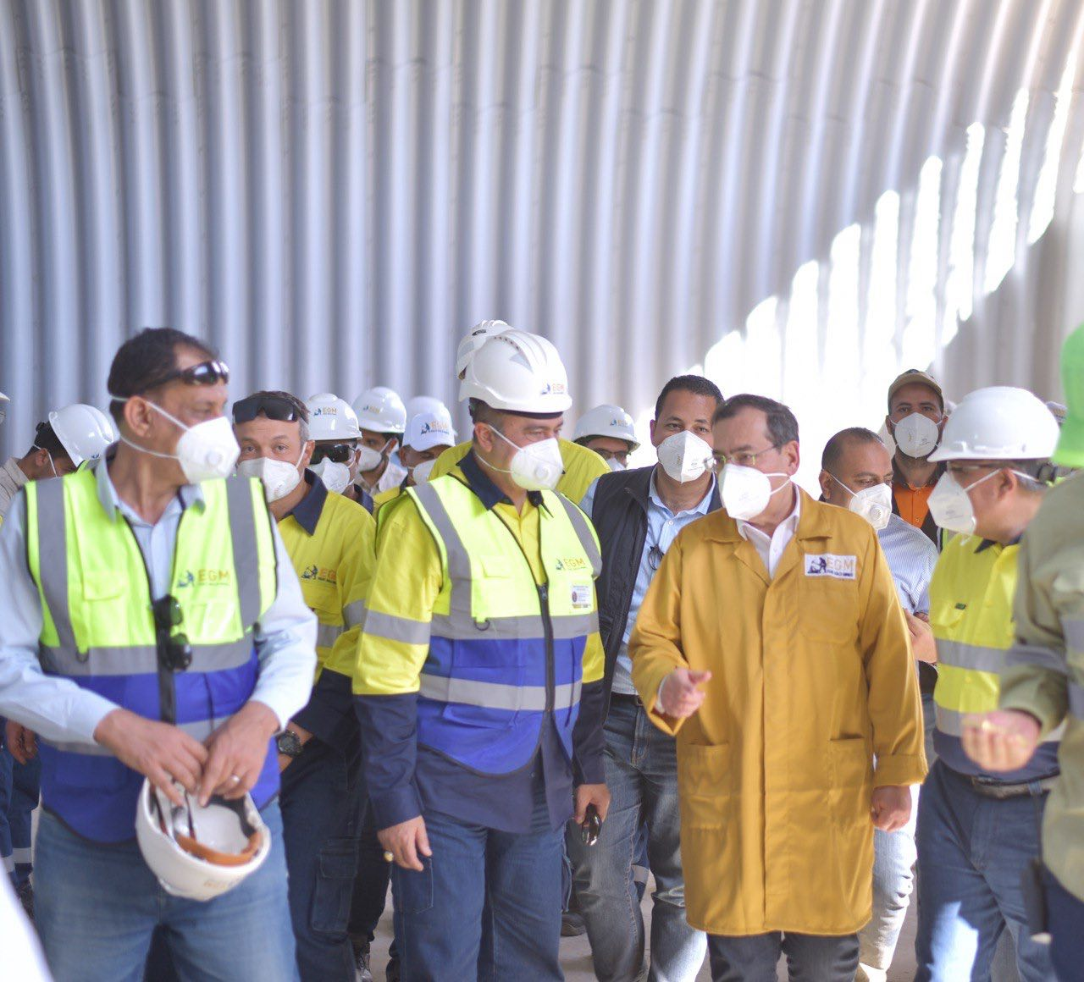
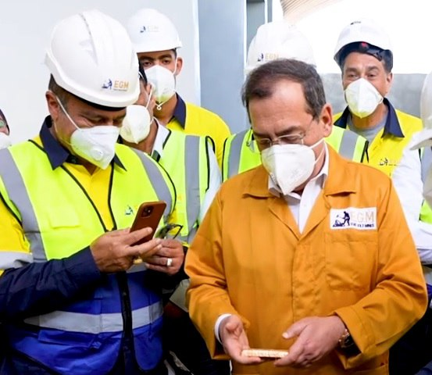
Wealth & Resources Mining S.A.E.
Minister of Petroleum & Mineral Resources visit to Eqat Mine Site (March 2023)
Notes:
Drilling at Eqat has been a logistical challenge due to the steep topography

Slide 39
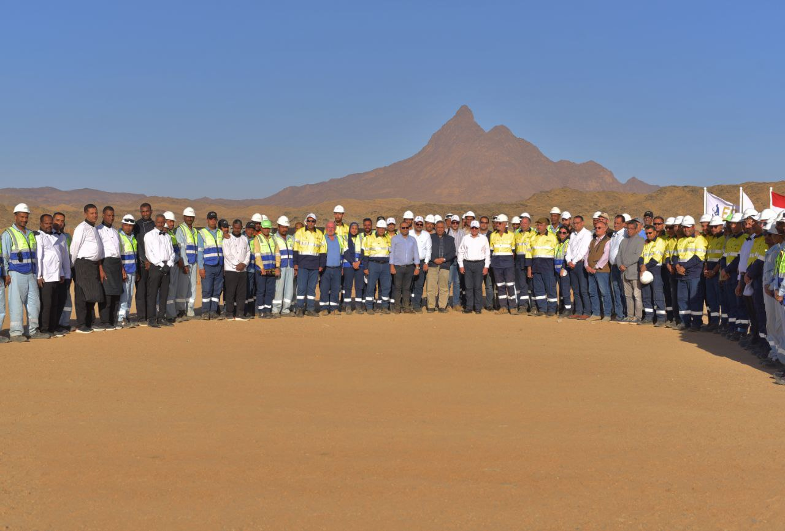
Wealth & Resources Mining S.A.E.
Notes:
Drilling at Eqat has been a logistical challenge due to the steep topography

